Slide 1
The Impact of Covid 19
In regards to drug abuse and overdose trends (2019-2024)

Slide 2
Various types of data reflecting in finance, healthcare and surveys.
Surveys
Healthcare
Finance

Slide 3
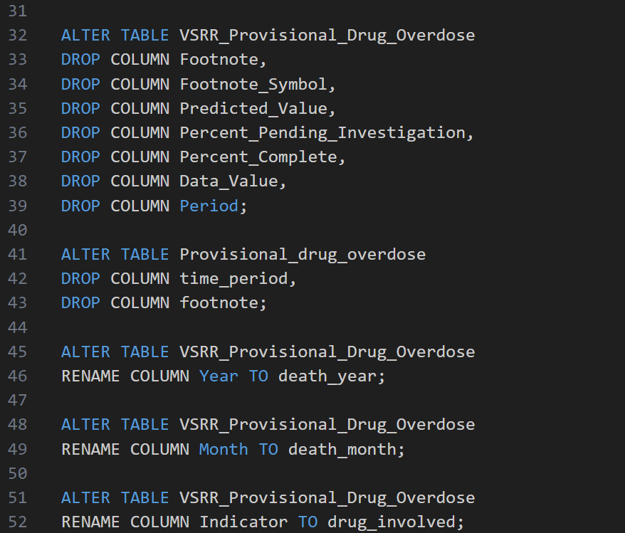
Importing of Dataset
This SQL script performs the following actions:
Create New Tables to store overdose data and statistics
Remove Unnecessary Columns by dropping multiple columns
Rename Columns for Consistency this aligns column names for easier data merging.
Notes:
Cleans and restructures overdose data.
Standardizes column names across tables.
Prepares the dataset for analysis or merging.

Slide 4
Analyzing Temporal, Geographic, and Substance Related Trends
Temporal Trends:
How did drug overdose death rates change before and after the COVID-19 pandemic?
Were there specific time periods during (or immediately following) the pandemic where overdose deaths peaked?
Geographic Analysis:
Which states or regions experienced the highest increases in overdose deaths post-COVID?
Are there any geographic patterns associated with changes in overdose rates?
Substance Analysis:
Did the types of substances involved in overdose deaths shift during the pandemic?
What role did synthetic drugs, such as fentanyl, play in post-COVID overdose rates?

Slide 5
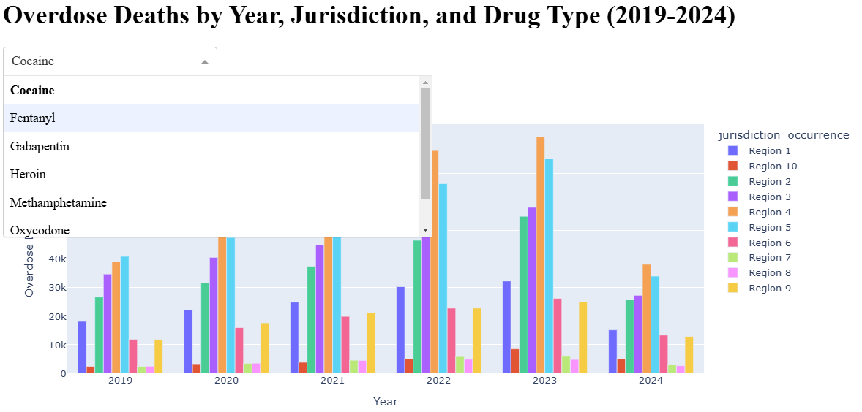
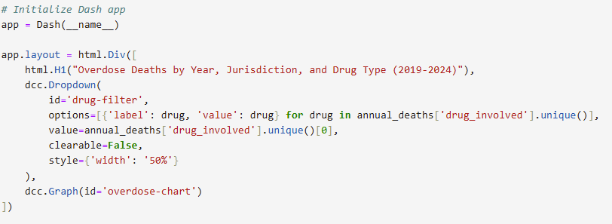
Visual 1: Geographic and Substance Analysis
* Only substance not visible in drop down box is Xylazine

Slide 6
Substance Analysis
Substance Analysis:
Did the types of substances involved in overdose deaths shift during the pandemic?
Yes, cocaine related deaths grew steadily for 6 of the 10 CDC Regions through 2023, then dropped suddenly in 2024, while heroine use actually decreased from 2019-2024
All 4 of the 7 major substances listed saw consistent increases in death rates through 2023, the other 3 either decreased (Heroin) or only saw a brief increase in mortality rates (Gabapentin and Oxycodone)
What role did synthetic drugs, such as fentanyl, play in post-COVID overdose rates?
Fentanyl, Methamphetamine, Gapabentin, and Xylazine are the only fully synthetic drugs included in this project. These drugs accounted for 57.5% of all reported drug related deaths in 2019 and increased to 74.7% by 2023.

Slide 7
Temporal Trend:
How did drug overdose death rates change before and after the COVID-19 pandemic?
Overdose trends show a consistent rise across all drugs except heroin until 2023. In 2024, overdose deaths dropped by over 50%.
Were there specific time periods during (or immediately following) the pandemic where overdose deaths peaked?
Overdose deaths peaked in 2023, followed by a drastic decline in 2024.

Slide 8
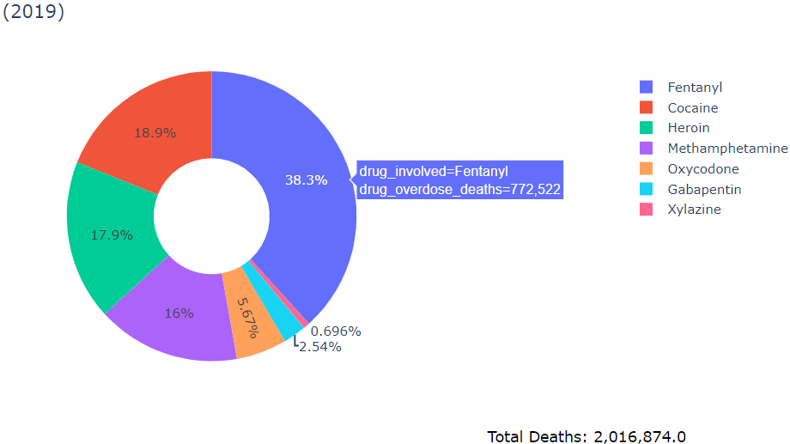
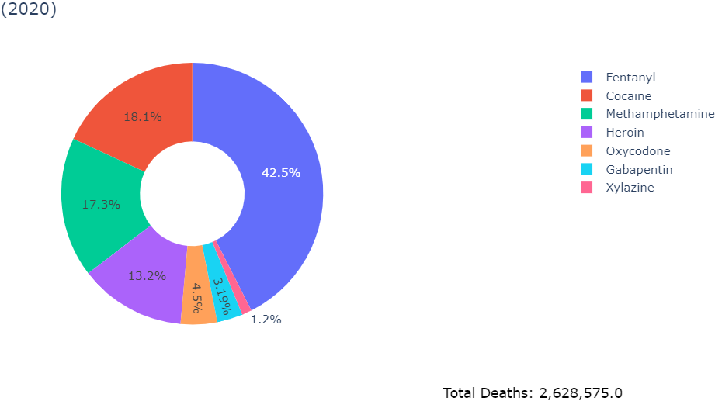
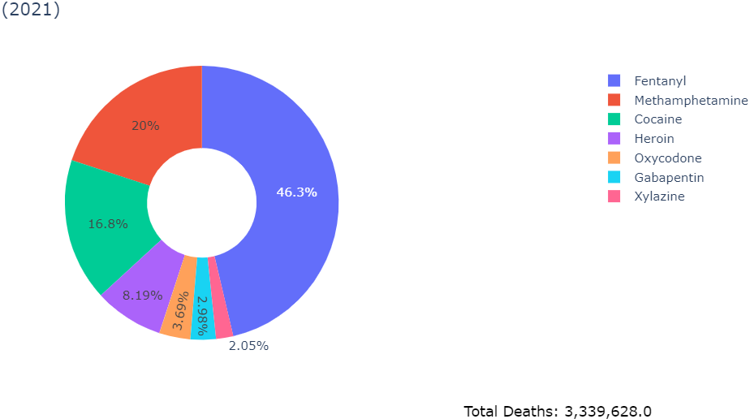
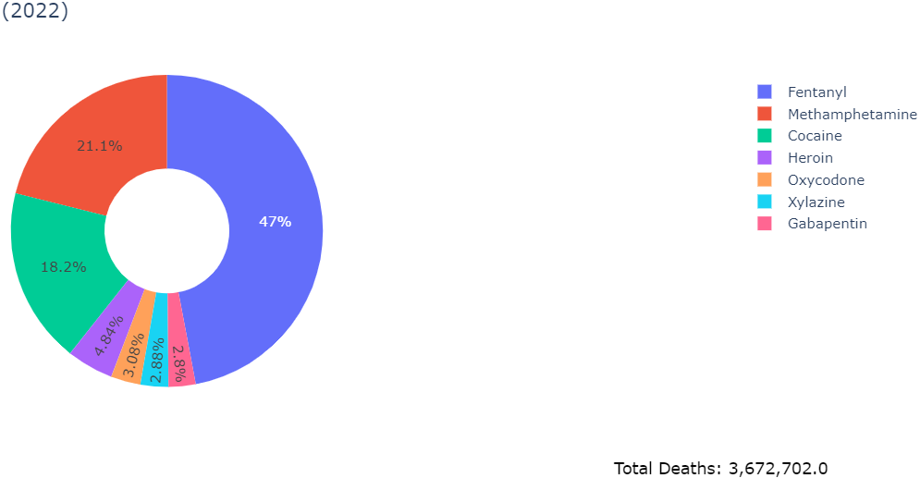
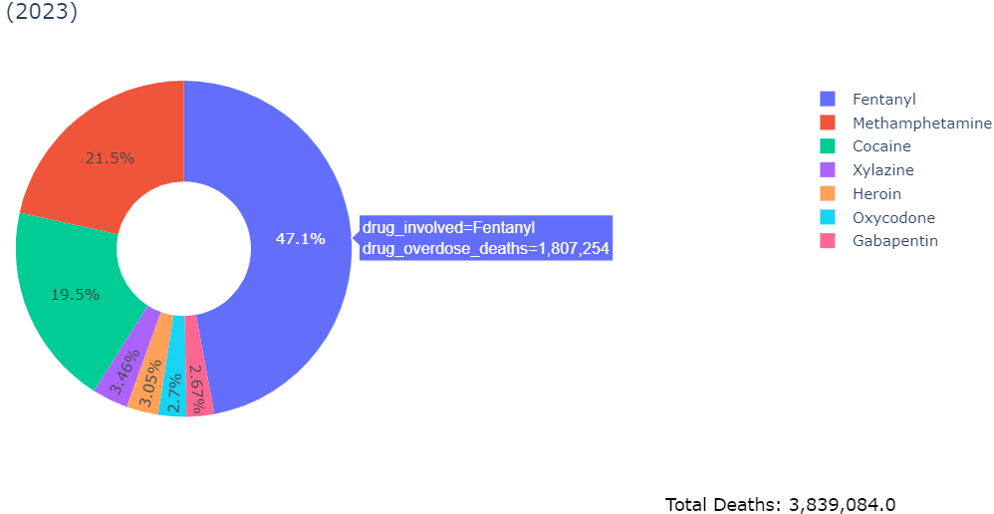
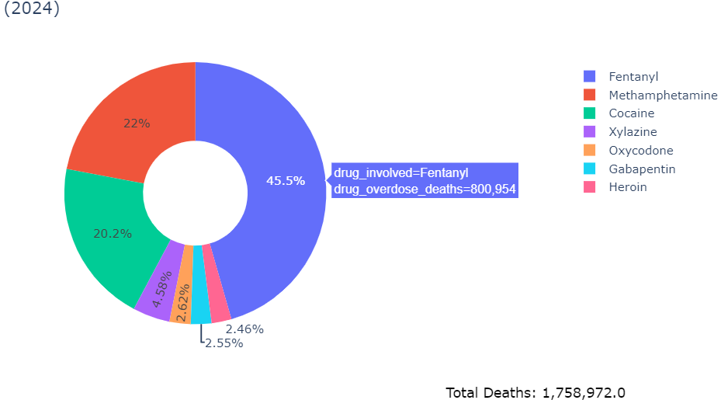

Slide 9
Geographic Analysis:
1.In this section we will differentiate the states or regions that experienced the highest increases in overdose deaths post-COVID.
2.Continuing analysis to see if there are any geographic patterns associated with changes in overdose rates.

Slide 10
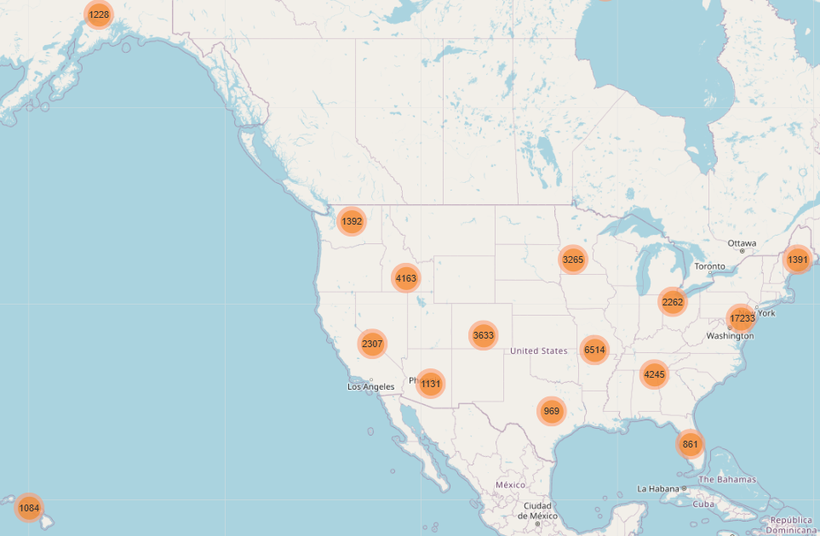
Geographic Analysis Visual
http://localhost:8963/lab/tree/OneDrive/Documents/interactive_map.html
Notes:
Inshirah – will review map

Slide 11


Slide 12
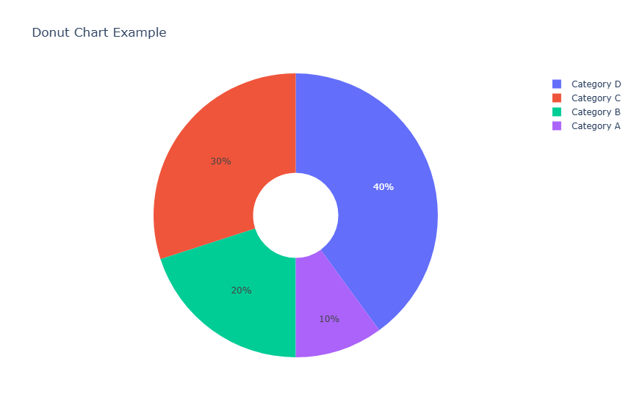
Overdose by Various Drug Types

Slide 13
Demographic Insights:
1. Were certain of the various demographic groups have disproportionately been affected by overdose deaths post-COVID such as.
2.Releating how these changes compare to pre-COVID trends.

Slide 14
Substance-Specific Trends:
Here we disclosed the data to showing if the substances involved in overdose deaths shift during the pandemic.
If so the synthetic drugs, such as fentanyl, play in post –COVID overdose rates.

Slide 15
Correlations with Pandemic Factors:
Here we discuss overdose death trends correlated with pandemic – related factors such as-.
1. Unemployment rates
2. Lockdown policies
3 Mental health services

Slide 16
Referenced Data Sources
Centers for Disease Control and Prevention (CDC):
https://data.cdc.gov/NCHS/VSRR-Provisional-Drug-Overdose-Death-Counts/xkb8-kh2a/about_data
Centers for Disease Control and Prevention (CDC):
https://data.cdc.gov/NCHS/Provisional-drug-overdose-death-counts-for-specifi/8hzs-zshh/data_preview

